Slide 1
TASK 2: FINDING VULNERABILITIES OF A GIVEN WEBSITE
PRAGYA PARAMITA DAS

Slide 2
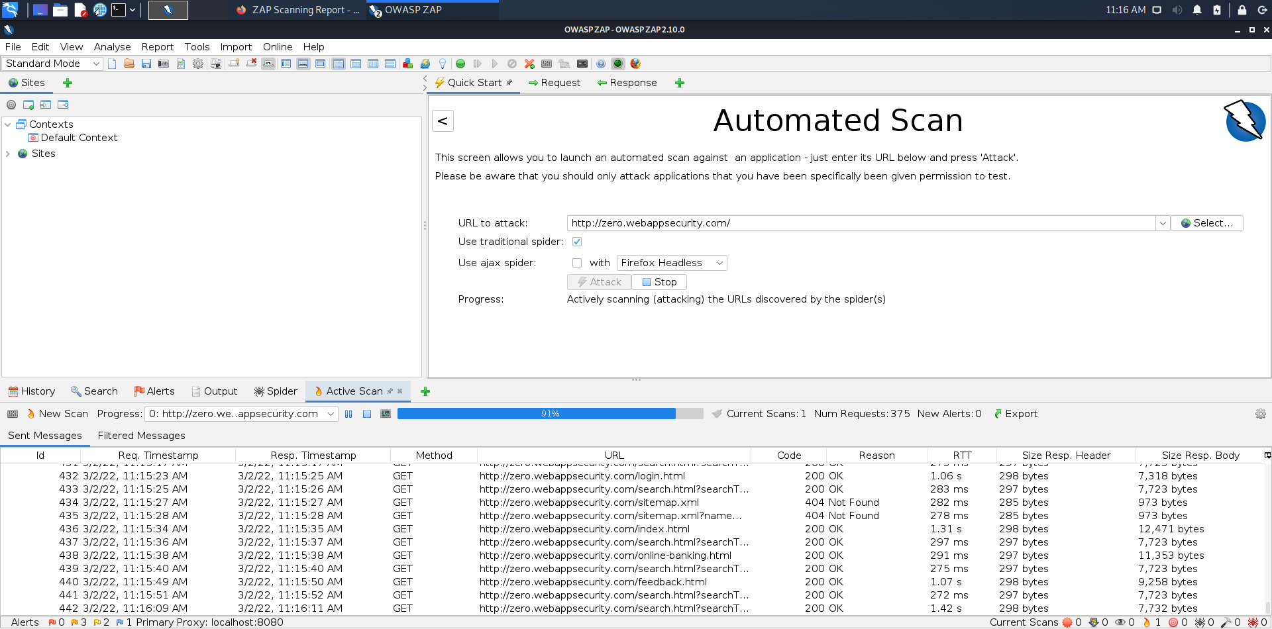

Slide 3
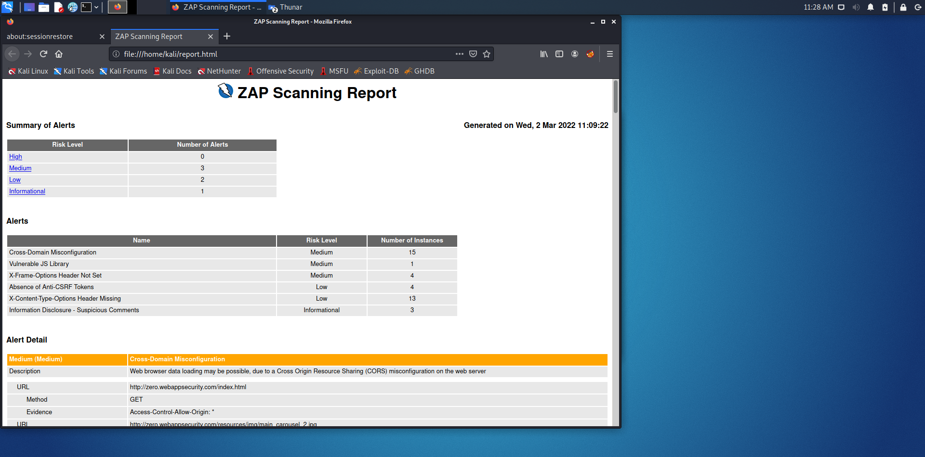

Slide 4
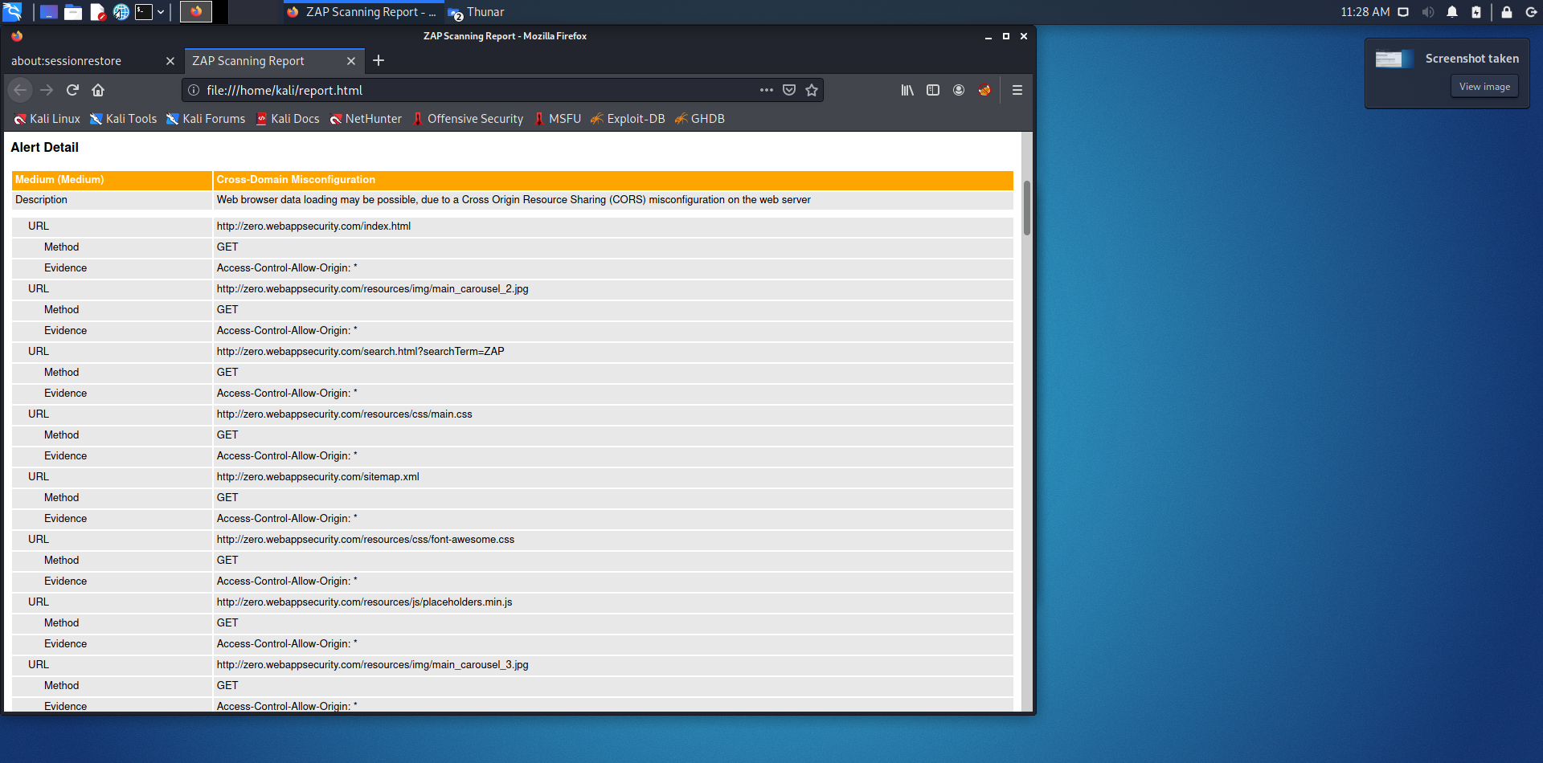
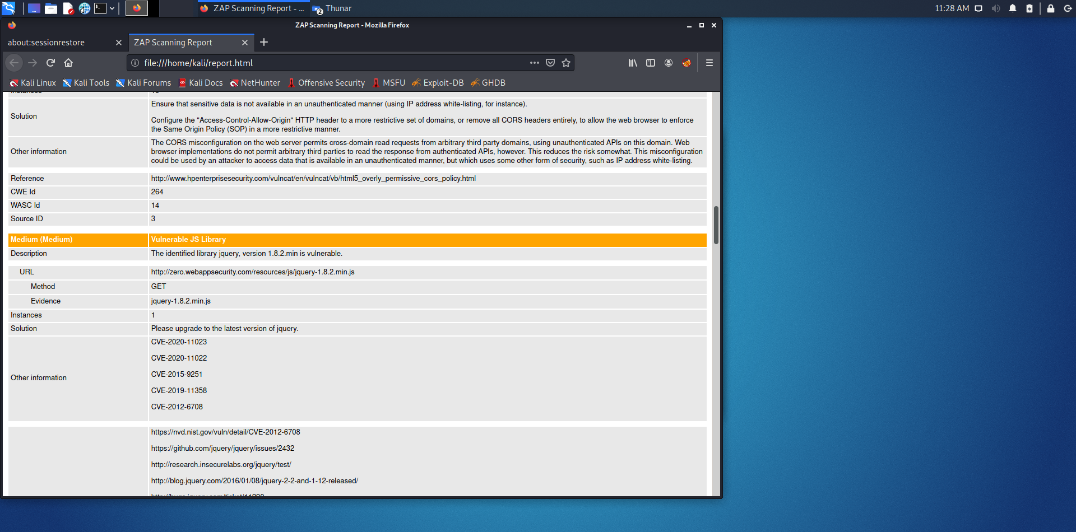

Slide 5
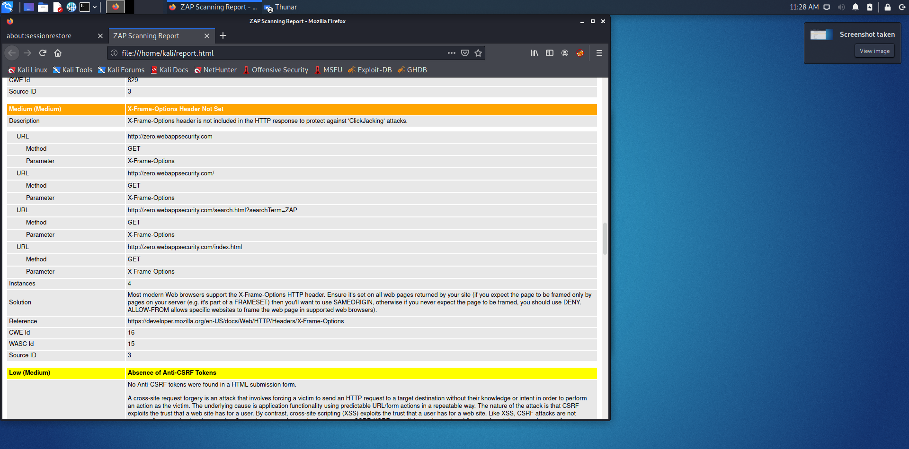

Slide 6
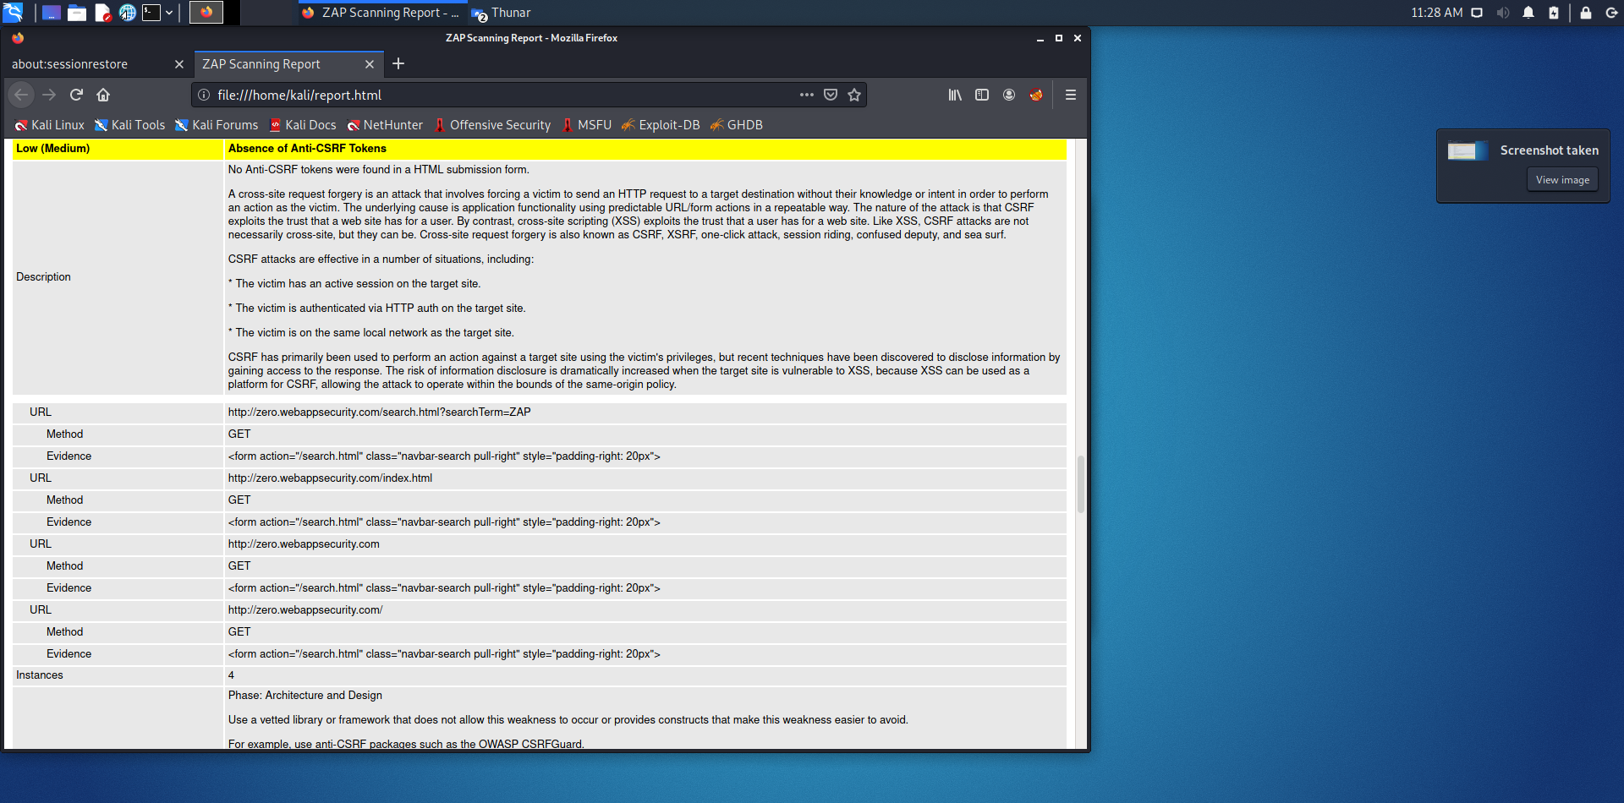

Slide 7
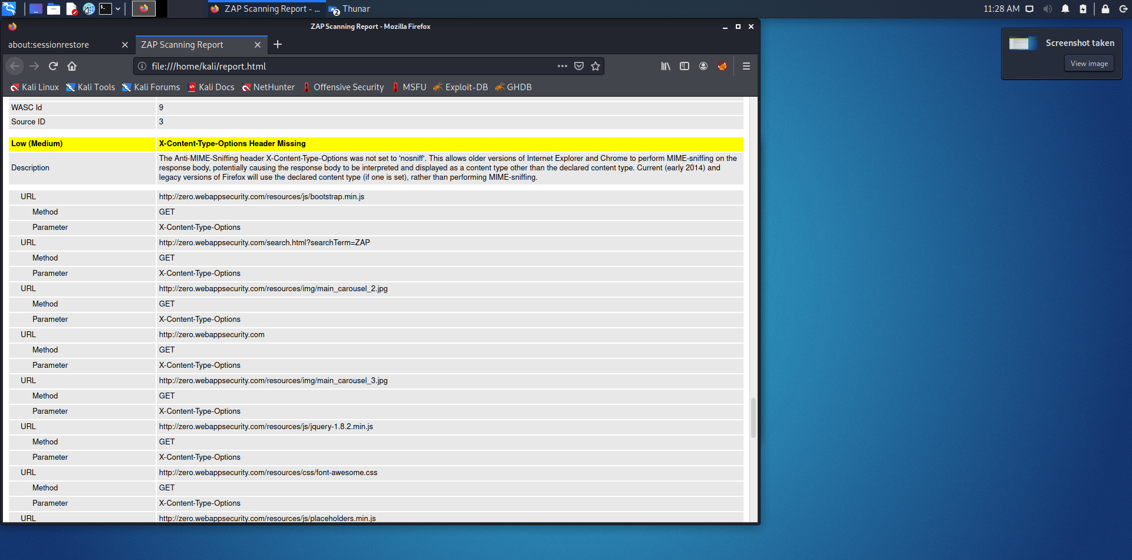

Slide 8
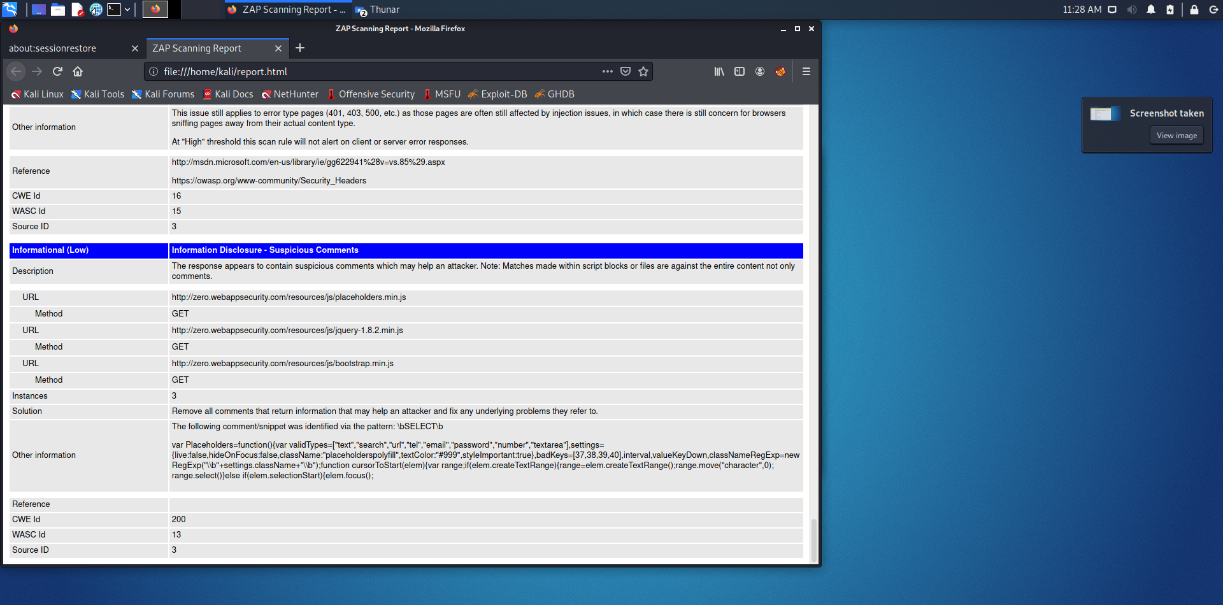

Slide 9
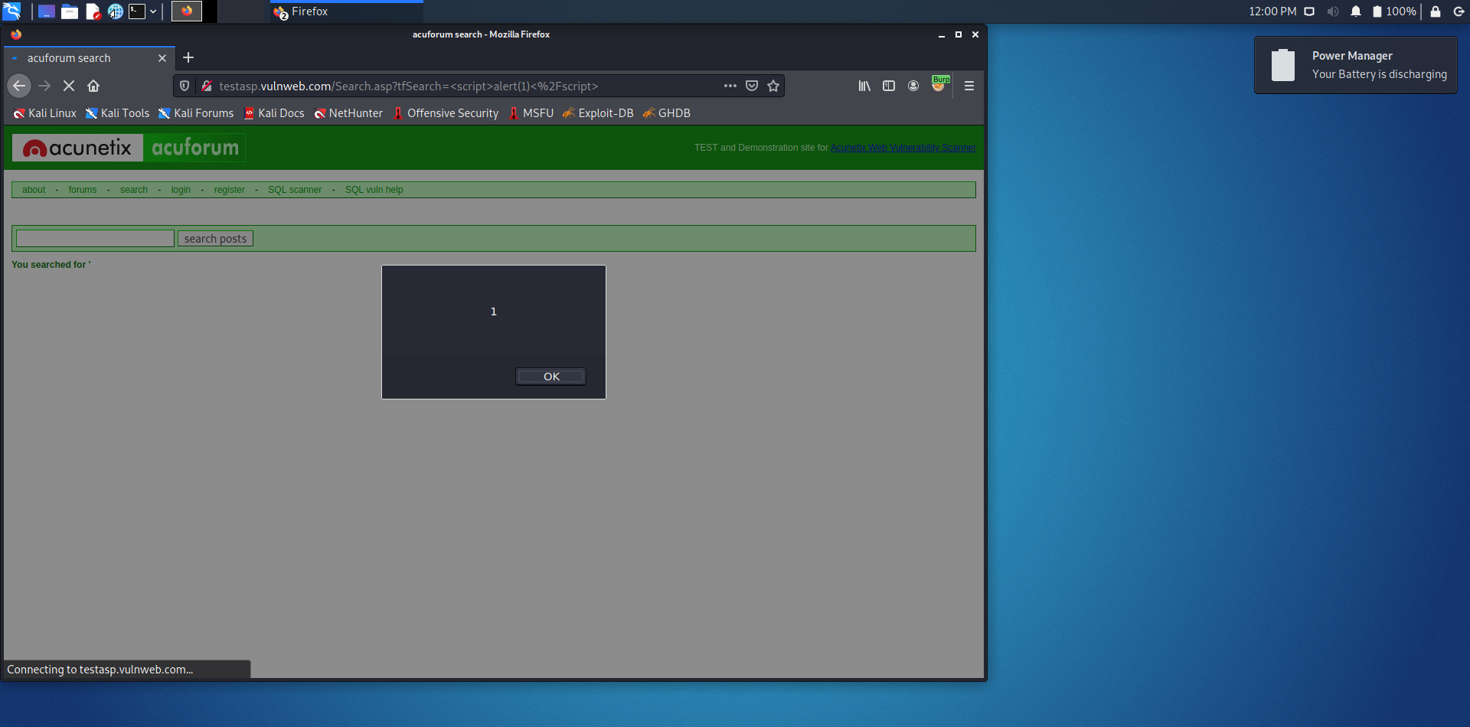

Slide 10
In report we can see, they are divided into four parts : Low :Vulnerability with low risks Medium :Vulnerabilities will medium risk Critical :Vulnerabilities with high risks , easy for black hat hacker to hack. Informational : Vulnerabilities which leak the critical information of the website

